Slide 1

School Management
System
Aneeza Sherani, BSCS, 5th Semester, Riphah International University Islamabad

Slide 2

Shell Scripting Overview
Automating School Operations with Shell Scripting
Platform:
Built on Linux/Unix using Bash Shell, a widely-used scripting language.
Purpose:
Simplifies and automates tasks like:
Student Management
Teacher Management
Course Handling
semester management
Features:
Menu-driven interface for easy use.
Modular code using loops, conditional statements, and functions.
Outcome:
A practical solution to automate tasks and improve productivity.

Slide 3

Objectives
1
Automate tasks
2
Data organization
Streamline school management processes
Structured storage and retrieval for easy access
3
Hands-on learning
Gain practical experience with Linux and Bash scripting

Slide 4



Key Features
Student Management
Teacher Management
Add, view, and delete student records
Organize and update teacher information
Course Management
Assign courses to semesters and manage course details
semester Management

Slide 5

File handling
Data Storage:
All school-related data (students, teachers, courses) is stored in plain text files for simplicity and accessibility.
Key Operations:
Reading Files:
Retrieve student, teacher, or course records effortlessly.
2. Writing to Files:
Update existing information or add new entries.
3. Appending Files:
Log changes or generate reports seamlessly.
4. Error Handling:
Manage file access issues, such as locks or invalid entries, ensuring smooth operations.

Slide 6




Technologies Used
Bash Scripting
Linux/Unix
Plain Text Files
Powerful scripting language for automating tasks
Robust and versatile operating system for running the application
Simple data storage for easy portability and management

Slide 7

How It Works
1
User input: selects a task from the menu
2
Bash script processing: executes the command and performs data operations
3
Output display: results shown in the terminal for user interaction

Slide 8
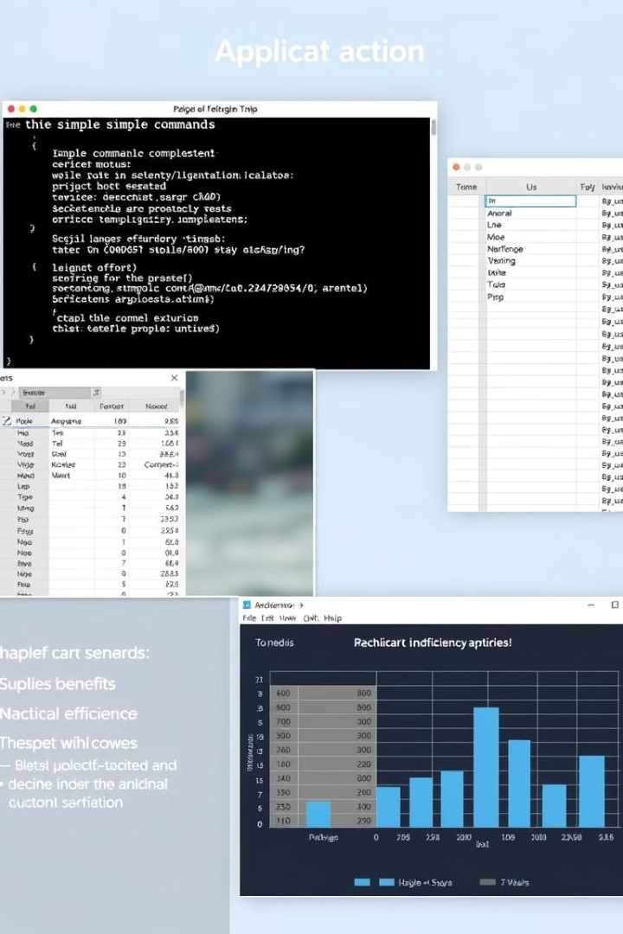
Results
1
Efficient management
Streamlined processes for school data
2
Quick access
Organized system for rapid data retrieval
3
Skill development
Enhanced understanding of scripting and Linux

Slide 9

Conclusion
The School Management System is a valuable tool for simplifying school administration, providing a structured and efficient way to manage data. It demonstrates the power of Bash scripting for automating tasks and enhancing productivity.

Slide 10

thanks

